Slide 1



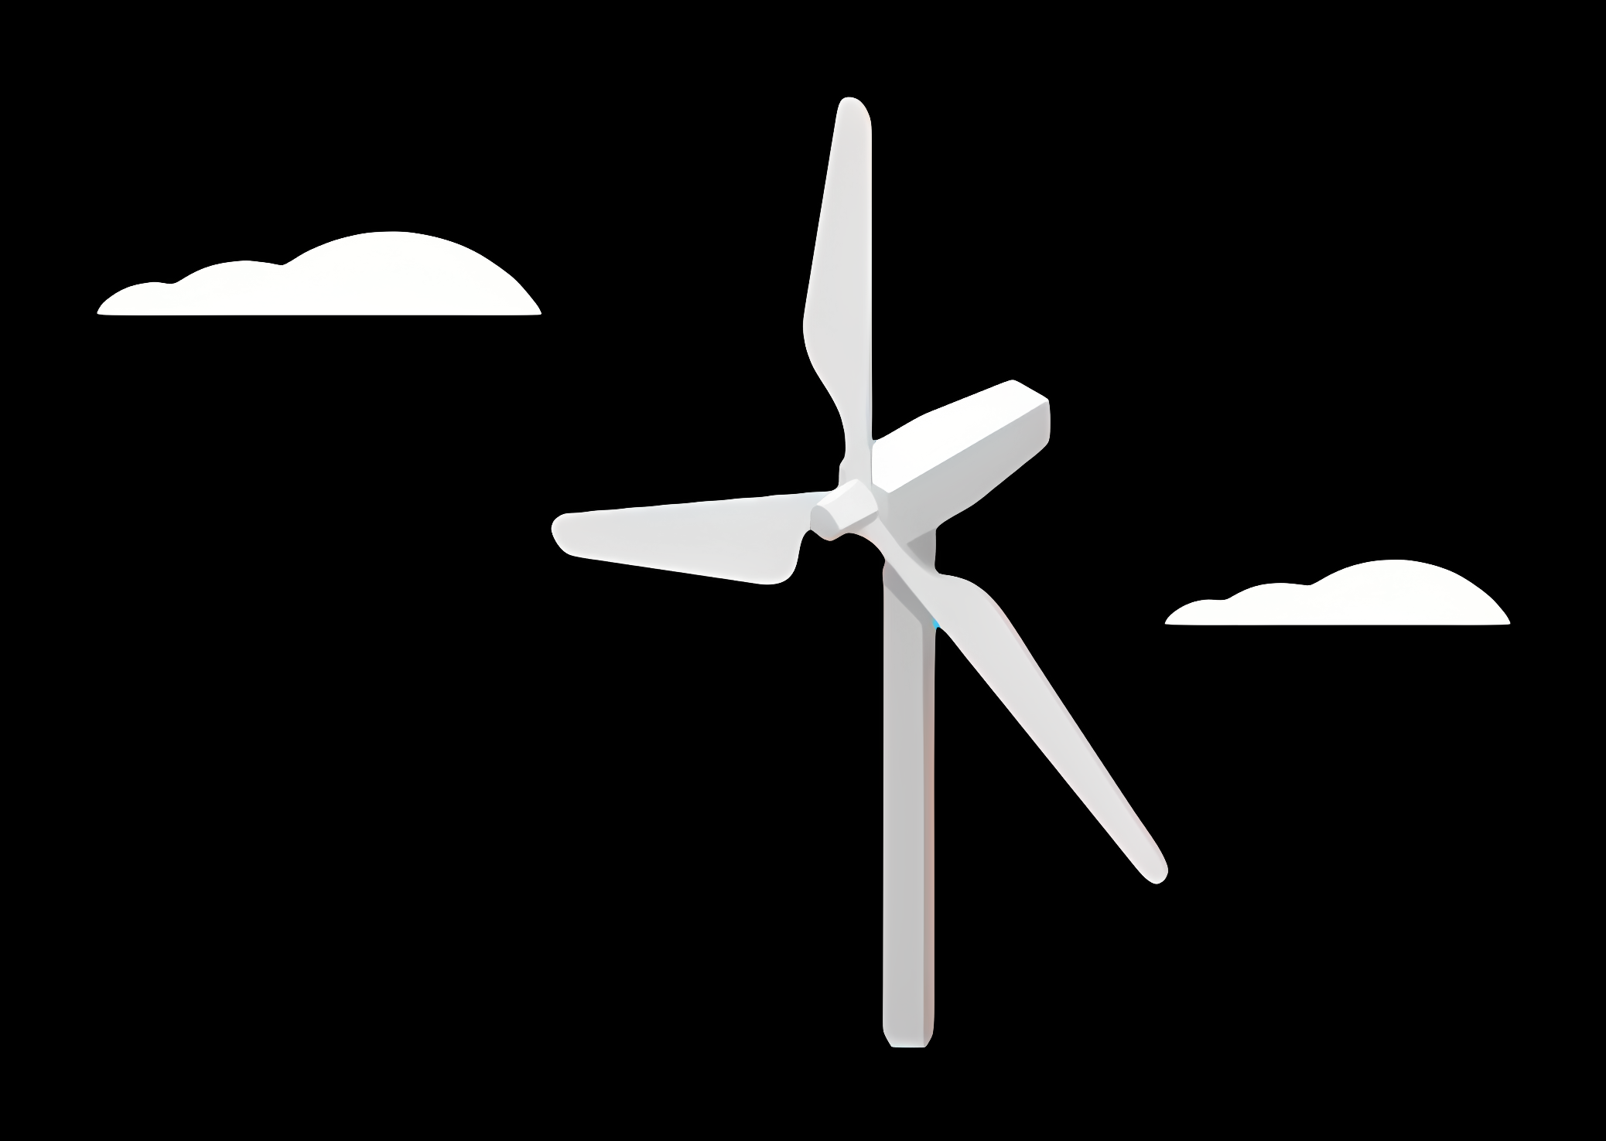
Weekly report: Team Project Development
Week number: 03 – Kick Off
Date: 14/10/2025
Supervisor: Dr. Marina Blohm
Group members: Ahmed Sallam, Luis Urhahn, Ceren Cetin, Sohail Mansuri
Presenter : Ahmed Sallam

Slide 2
List of content
1. Caratria of site selection
2. Wind speed calculations
3. Energy profile Syria
4. Site Comparison
5. Distance Analysis
6. Noise Regulation Context
7. Site final decision (Project Development Team)
Sila Ceren Cetin-770819

Slide 3
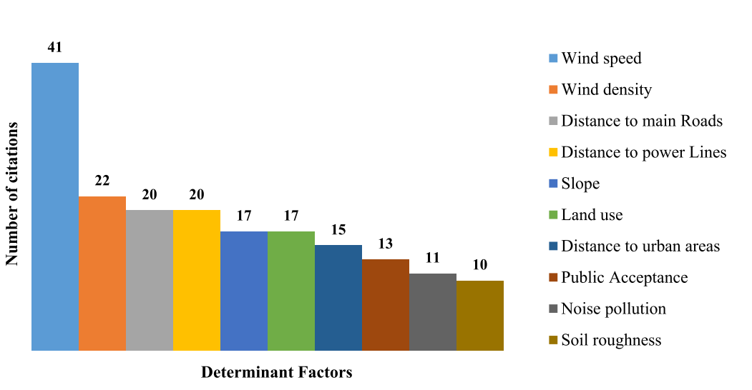
Criteria of site selection
Identify No-Go Factors
Optimize Factors
Balance Contradictory Criteria
Set Priorities
For site selection in Syria, all factors must be considered based on the available data. Critical constraints should be identified, favorable conditions optimized, and conflicting criteria balanced for informed decisions
Wind power plant site selection: A systematic review

Slide 4
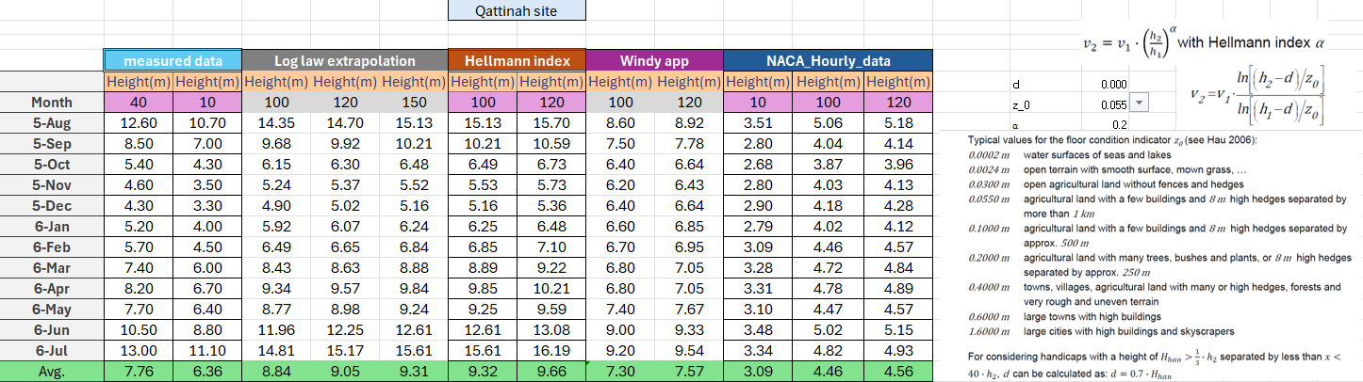
Wind Speed calculations:

Slide 5
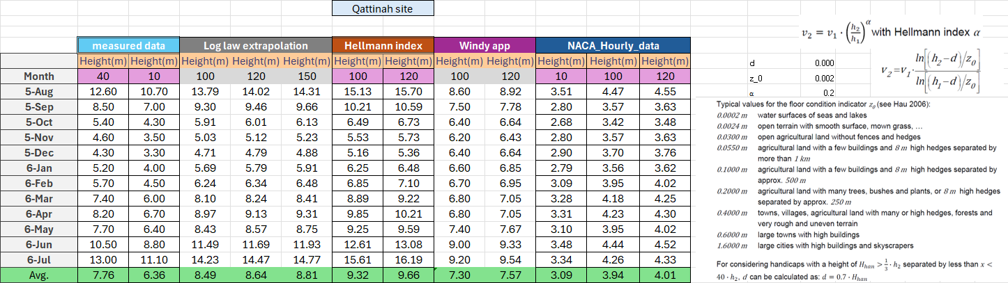
Wind Speed calculations:

Slide 6
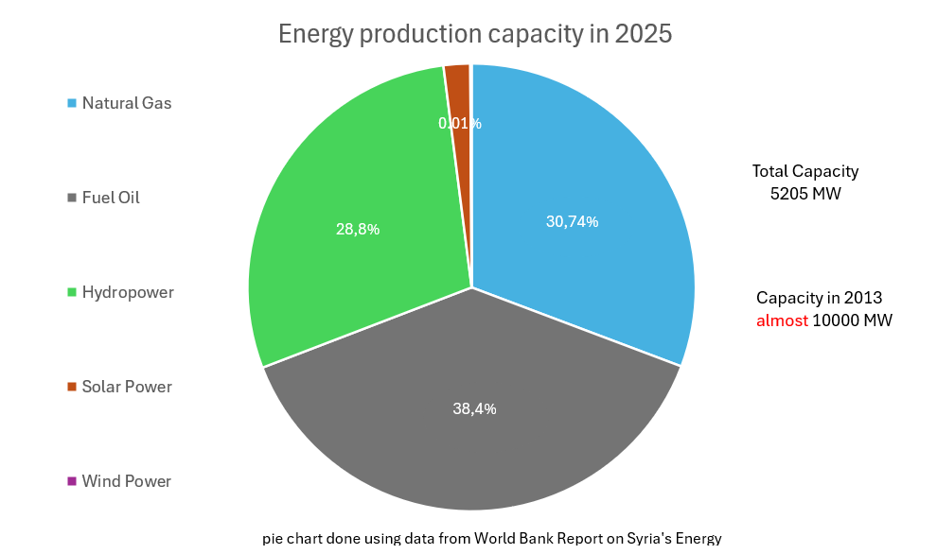
Energy profile in syria
Grid regulation of a maximum allowable percent of 30 % for certain region
to maintain grid stability and avoid frequency and voltage fluctuations
According to IPP tender
Recommendation choose a site with high suitable demand and relevant portion of conventional power plants sizing storage system with respect to these risks of Black out
World Bank. (2011). Syria energy sector assessment and recovery plan (Report No. 499230ESW0P11010). World Bank Group

Slide 7
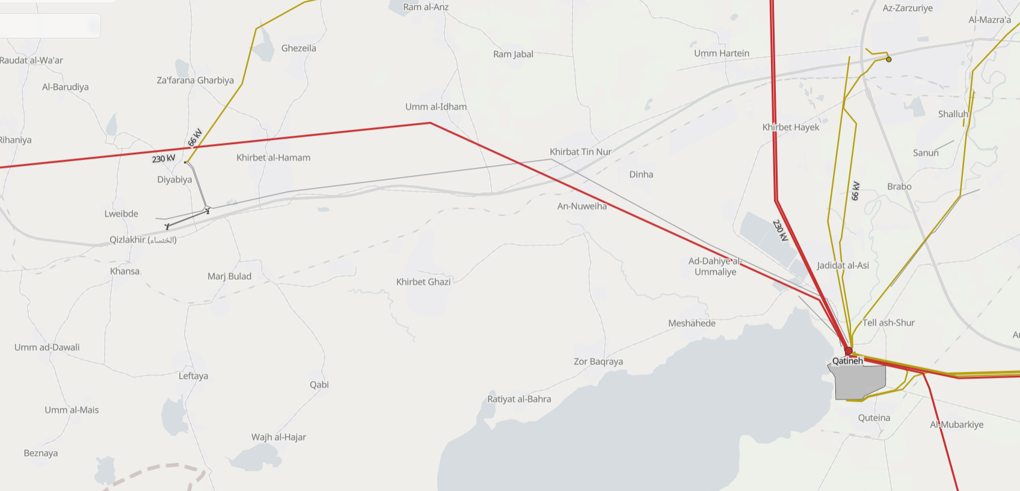
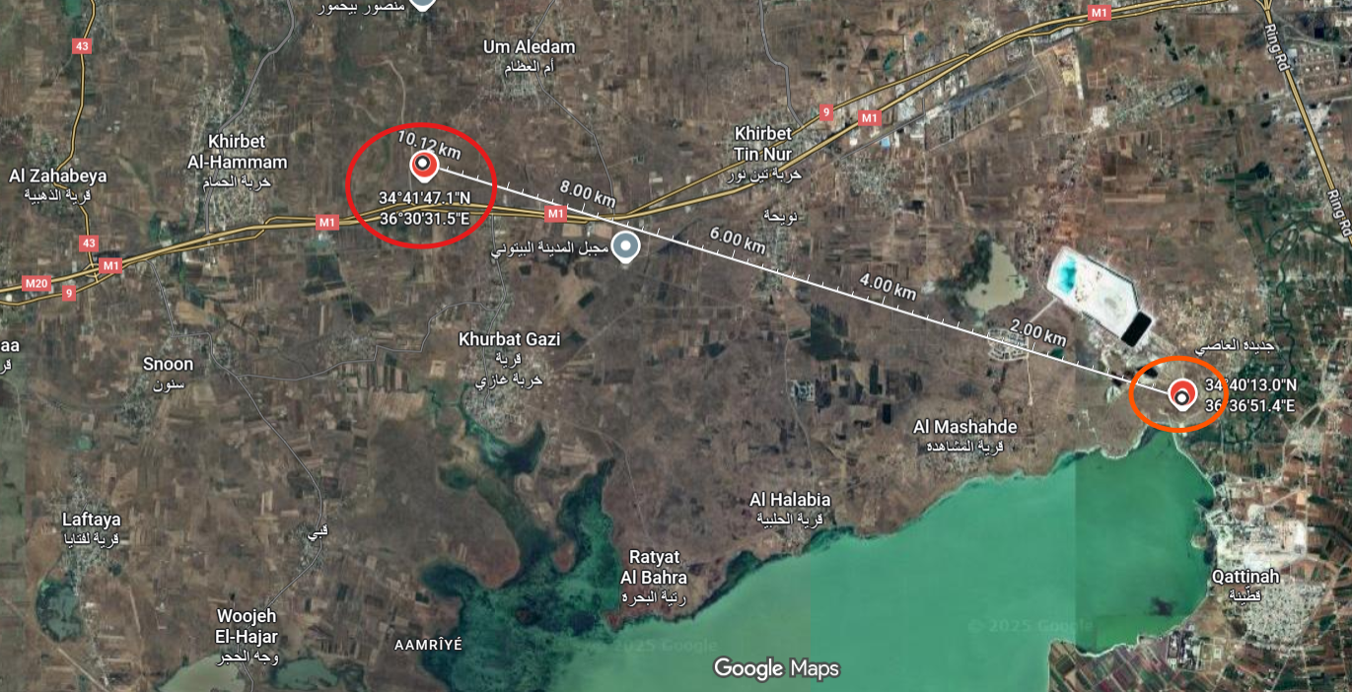
Site Comparison
Um_Aledem
Qattinah
2*2.5 Mw WT

Slide 8
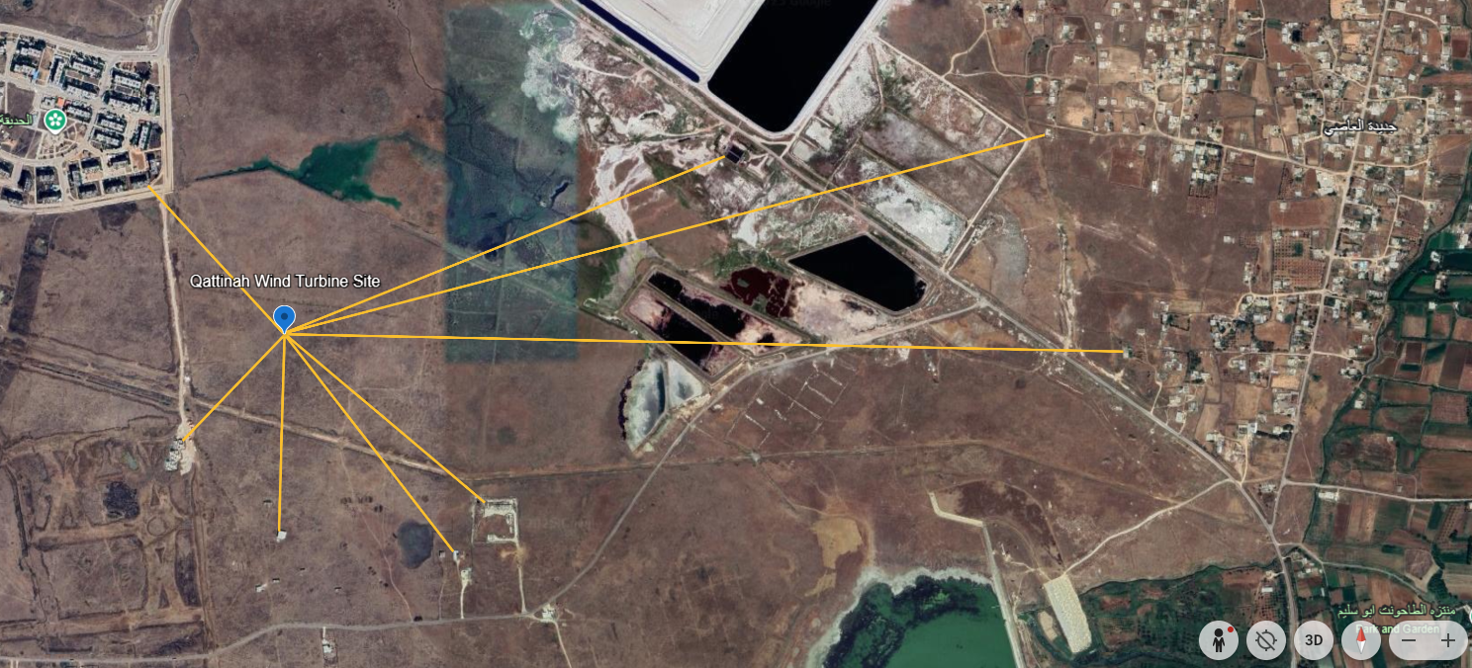
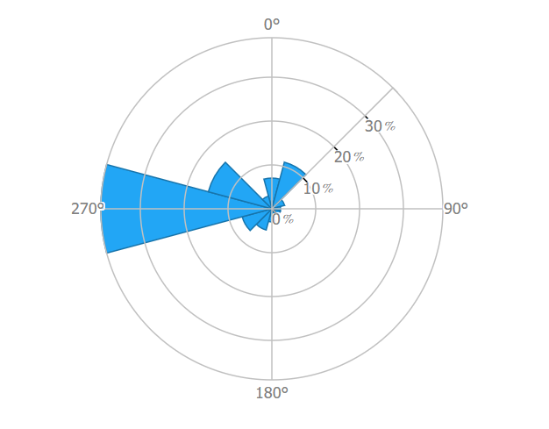
OLD Distance Analysis– Qattinah
Final Turbine Location: 34°40'25"N
36°35'44"E
Building | Distance [m]
Building A | 440 m
(Building B)* | 1 041 m
Building C | 1 724 m
Building D | 1 845 m
Building E | 577 m
Building F | 603 m
(Building G)* | 428 m
(Building H)* | 321 m
B
C
A
D
H
E
G
F
* Not sure about the building
Figure 2: Distances in Qattinah [GoogleEarth]
Ahmed Sallam
Notes:
Shows the distances to the surrounding buildings.
In general the distance is longer to the surrounding buildings, especially in the main wind dirction, which is cruicual!
Regarding the buildings A, the shaddow flicker will be a problem, but only in the morning ours.
With the buildings F-H, I am not sure if they are in use. I assume its for farmers or so.
In my opinion its the better side now. Only the amount of water resources could be a major problem, but according to the soil analysis it will not be a problem!

Slide 9
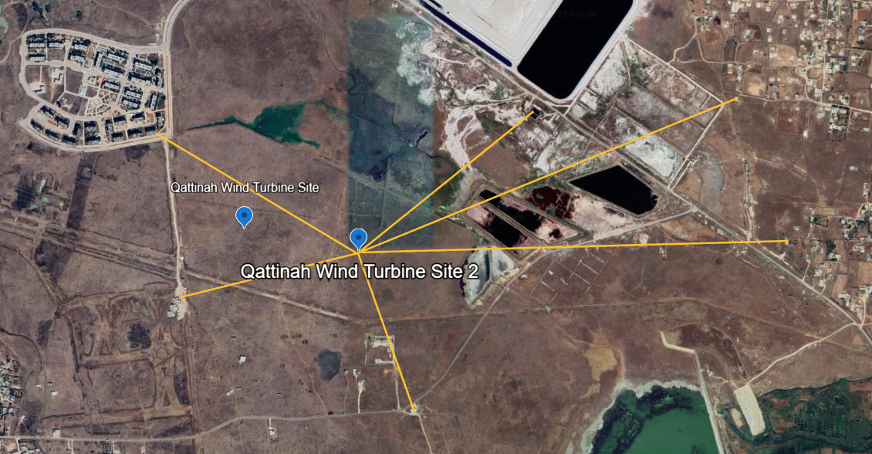
Update Distance Analysis– Qattinah
Final Turbine Location: 34°40'22"N
36°35'59"E
B
A
C
Building | Distance [m]
Building A | 800 m
Building B | 767 m
Building C | 1 396 m
Building D | 1 469 m
Building E | 577 m
Building F | 629 m
B
C
A
D
D
H
F
E
G
E
F
Barns or ruins
Figure 3: Distances in Qattinah [GoogleEarth]
Ahmed Sallam
Notes:
Shows the NEW distances to the surrounding buildings.
In general the distance is longer to the surrounding buildings, especially in the main wind dirction, which is cruicual!
The red numbers are critical but not in the main wind direction.
Within the red circles we assume that these are not actual buildings, looks like barns or ruins

Slide 10
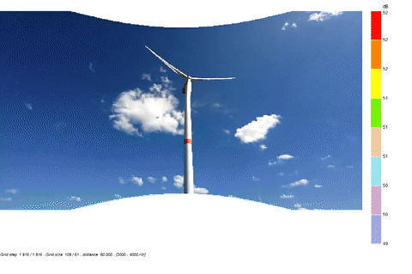
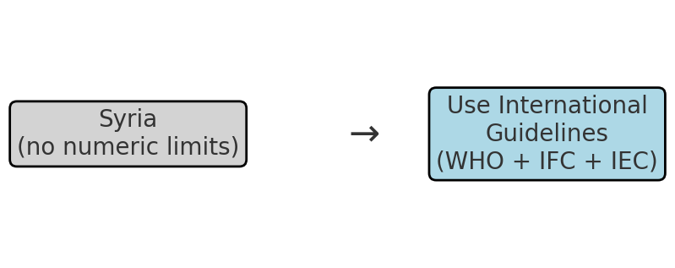
Noise Regulation Context — Syria
• Syria’s Environment Law No.12 (2012) forms the main legal framework for environmental protection.
• No publicly available numeric limits for wind turbine noise are specified in current Syrian legislation.
• Therefore, international best practices are used for project assessment (WHO, IFC, IEC).
References: Environment Law No.12 (2012); WHO Environmental Noise Guidelines (2018); IFC EHS Guidelines (Wind Energy); IEC 61400‑11.
References: SIEMENS
Ahmed Sallam

Slide 11
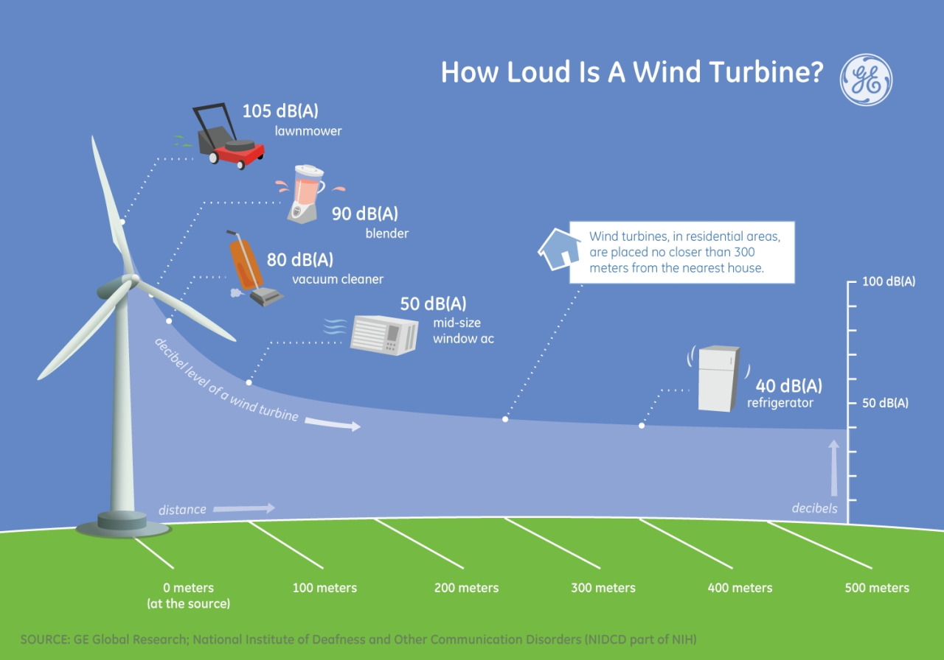
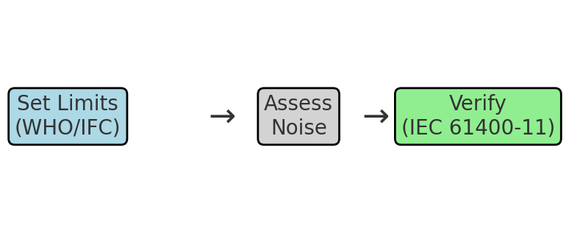
Recommended Noise Criteria for Wind Turbine Project
Proposed Project Criteria:
• Health-based limits: ≤ 45 dB Lden (day-evening-night) and ≤ 40 dB Lnight.
• Alternative rule: Background + 3 dB(A), whichever is stricter.
• Verification method: IEC 61400‑11 (turbine noise measurement).
References: WHO Environmental Noise Guidelines (2018); IFC/World Bank EHS Guidelines; IEC 61400‑11.
Ahmed Sallam

Slide 12
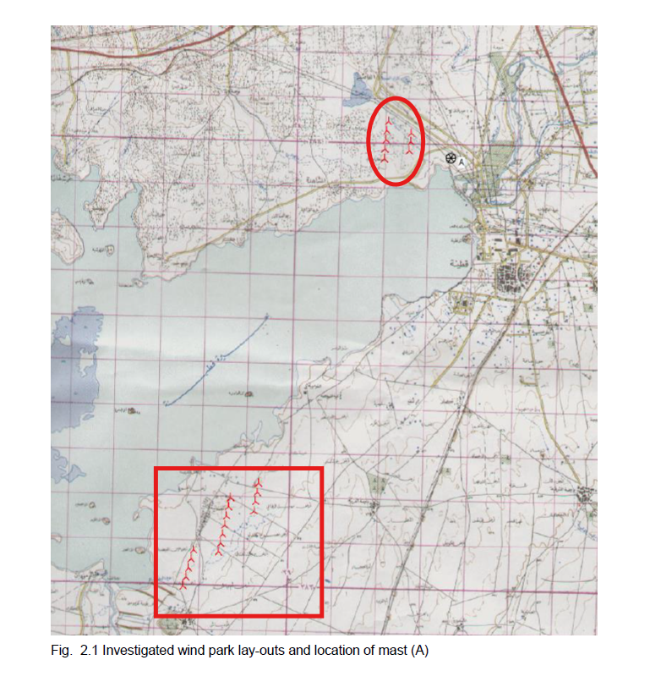
Site final decision
1
Prefeasibility study of Decon company in Qattinah :
the north shore scenario of 8 turbines with 1,5 MW
2. the south scenario of 16 turbines of 1,5 MW each
Hub height of 64.7 m
Final Turbine Location: 34°40'22"N
36°35'59"E
Complex soil condition
the tests of the WAsP (Wind Atlas Analysis and Application Program) model have shown: that there are some shortages in the prediction of the height profile.
2
the limitation in the roughness description
2. general climatic effect caused by the lake
Ahmed Sallam

Slide 13
CRITICAL ASSESSMENT OF THE RESULTS
Located within a tender area with government-owned land, simplifying permitting and land acquisition.
Situated in a safe grid zone, ensuring compliance with the limit of 30% renewable energy penetration under the IPP scheme.
Proximity to the high-voltage grid, reducing connection costs and losses.
Confirmed soil suitability after discussion with the geotechnical team, ensuring the feasibility of foundation reinforcement for turbines reaching 120 m hub height.
Ahmed Sallam

Slide 14
References
[1] Global Wind Atlas, Global Wind Atlas. [Online]. Available: https://globalwindatlas.info/en/. [Accessed: Sep. 17, 2025].
[2] Google Earth, Google Earth Web. [Online]. Available: https://earth.google.com/web/@34.29977563,36.68817928,1384.78342427a,853580.17318904d,35y,0h,0t,0r/data=CgRCAggBOgMKATBCAggASg0I____________ARAA. [Accessed: Sep. 17, 2025].
[3] Google Maps, Google Maps. [Online]. Available: https://www.google.com/maps. [Accessed: Sep. 17, 2025].
[4] Open Infrastructure Map, OpenInfraMap. [Online]. Available: https://openinframap.org/#10.04/33.2058/36.2058. [Accessed: Sep. 17, 2025].
Wind power plant site selection: A systematic review https://doi.org/10.1016/j.rser.2021.111293/

